Slide 1
Visit my website:
SAMISPEAKS.COM

Slide 4
SAMI’s MISSION
EMET (TRUTH In HEBREW)
EDUCATE the next generation (historical facts)
MOTIVATE to be the best they can be
EMPOWER to become active and UPSTANDERS
TOLERANCE by accepting other peoples opinion and culture

Slide 6
REMEMBER:
All the tragedies in the world start/ed with WORDS
and
BULLYING

Slide 7
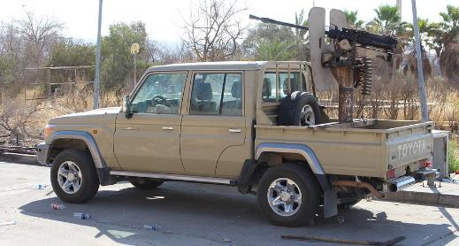
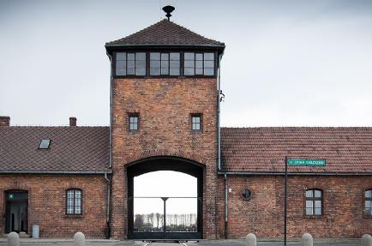
HOLOCAUST
systematic, bureaucratic murder of
6,000.000 European Jews sponsored by the state
GENOCIDE
Articles in media:
Daily Mail (3/2/13)
NYT (3/3/13)
42,500 different type of camps
GENO = GROUP CIDE = MURDER (infanticide, homicide, suicide…)

Slide 8
GENOCIDE
GENO = GROUP CIDE=MURDER
(infanticide, homicide, suicide)
10 STAGES of HOLOCAUST and GENOCIDE
By Dr. GREGORY H. STANTON
Early SIGNS
1. CLASSIFICATION (US vs THEM)
2. SYMBOLIZATION (triangles with various colors, signs, letters, etc.)
3. DISCRIMINATION (segregation, apartheid, etc.)
4. DEHUMANIZATION (portrayed as animals: rats, pigs, monkeys, etc.)
5. ORGANIZATION (usually by the state)
6. POLARIZATION (groups are driven apart)
7. PREPARATION/IDENTIFICATION (ghettos and various camps)
Final IMPLEMENTATION
8. PERSECUTION (separate victims by ethnicity, religion, prisoners of war, etc.)
9. EXTERMINATION
10. DENIAL

Slide 9
IDEAS to EXPLORE
1.) The background of the Holocaust (Germany)
2.) The Holocaust (The violence)
4.) The Holocaust (Ukraine / Murder-by-bullets)
3.) The Holocaust (Museum of the EXTINCT JEWISH RACE)
5.) The Holocaust (Comparing the past to the present)
6.) The Holocaust (Holocaust and Israel)
7.) The Holocaust (Using the proper words. False narratives)

Slide 10
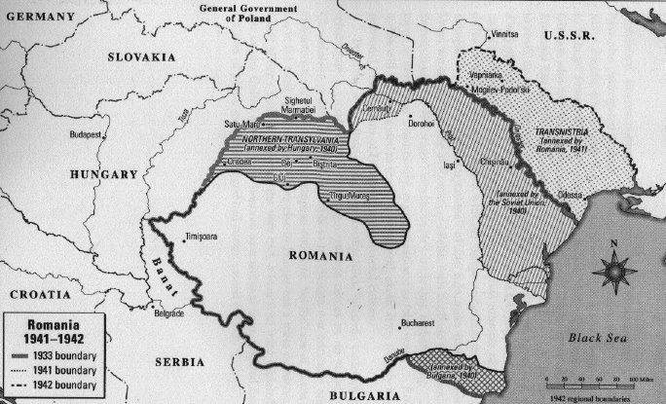
Where I was born
Labor camp

Slide 11
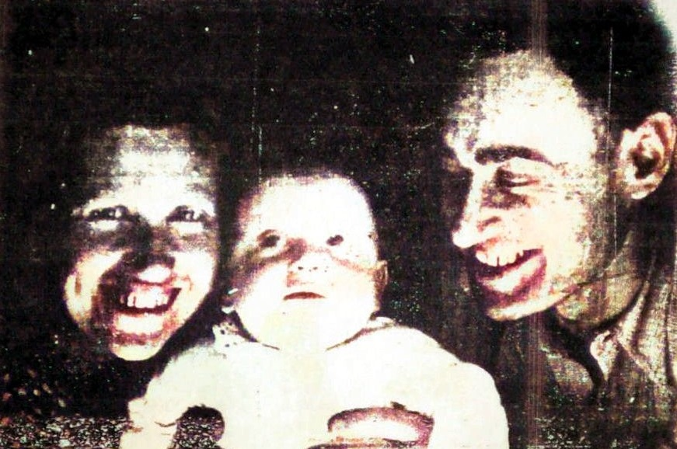
CZERNOWITZ (1939)

Slide 12
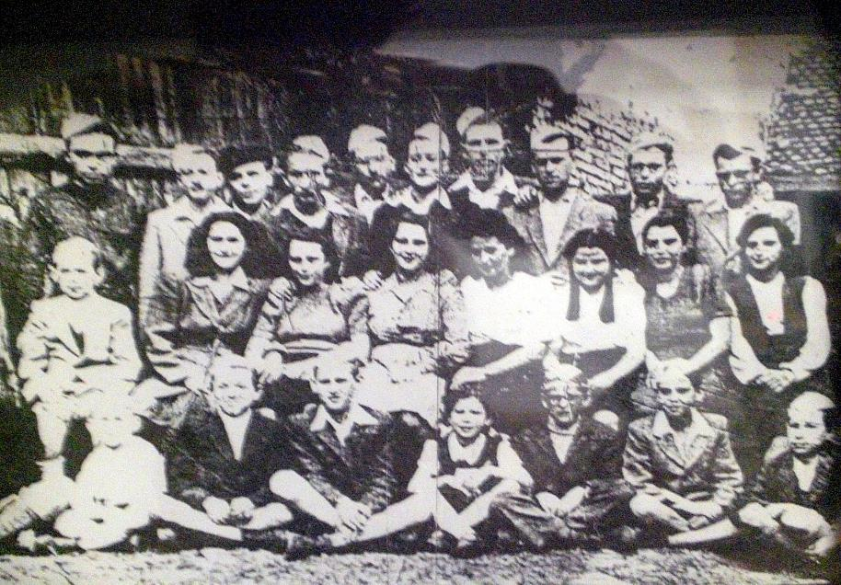
BNEI AKIVA (Religious Zionist Youth Group)

Slide 13
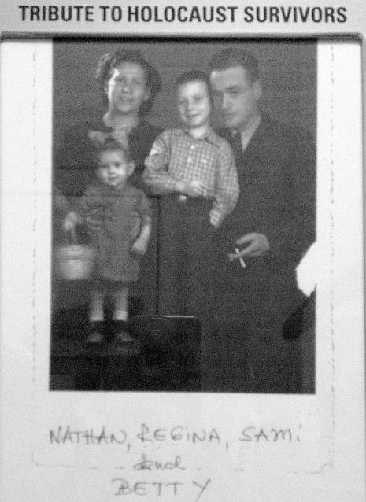
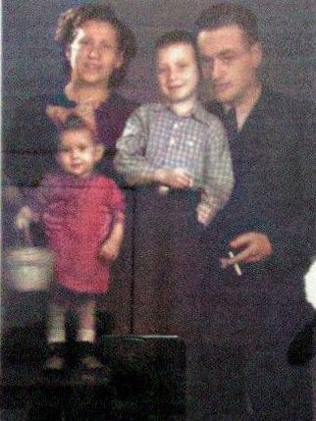
1947 in REGHIN (TRANSYLVANIA)

Slide 14
VICTIM and SURVIVOR
Not only of the Holocaust, but also after the war.
MOTIVATIONAL SPEAKER
Teaching life lessons (overcoming obstacles and challenges) based on my personal experiences.

Slide 15
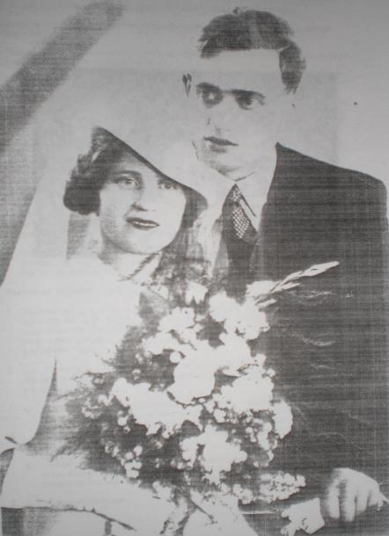
Reghina & Nathan

Slide 16
The whole world participated
Antonescu ordered massive reprisals. By noon the next day,
thousands of Jews and Communists were shot or hanged in the streets.
19,000 Jews were taken
to the harbor square, where they were covered in gasoline and then burned.

Slide 17
THE DEPORTATION
Most of the Jews remaining in Bessarabia and Northern Bukovina
after the summer and autumn massacres, were deported to camps and ghettos in Transnistria
Many died on the way, and two-thirds perished in Transnistria from epidemics, famine, and shooting

Slide 18
Q & A

Slide 19
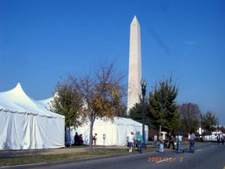
HISTORY vs LIVING HISTORY

Slide 20
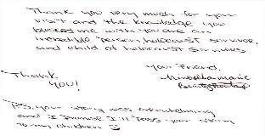
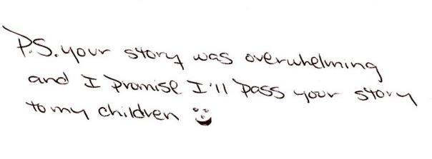
YOU have the power
to
CHANGE somebody’s life.

Slide 21
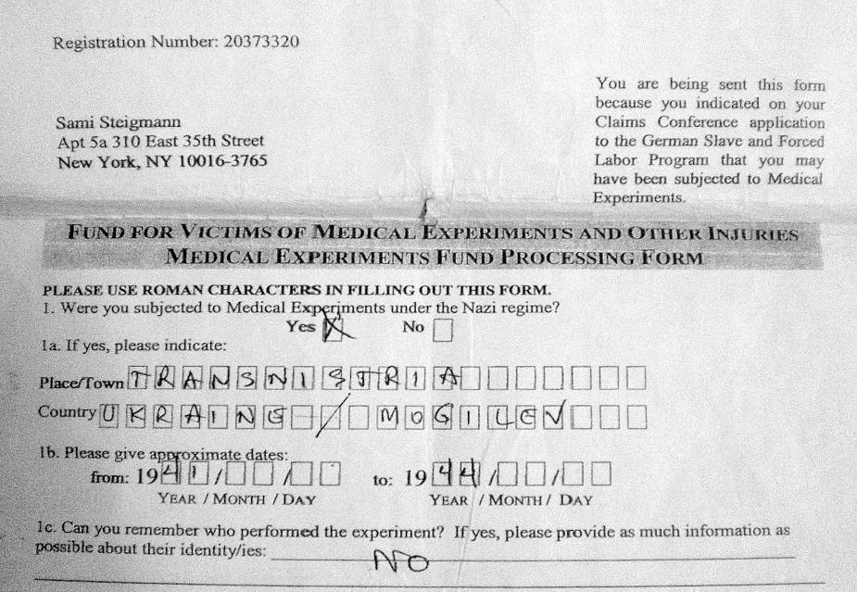
Application to Fund for Victims of Medical Experiments

Slide 22
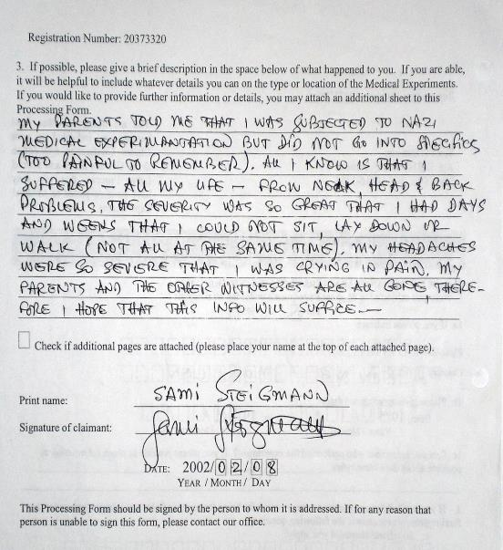
“My parents told me that I was subjected to Nazi medical experimentation,
but did not go into specifics… All I know is that I suffered – all my life –
from head, neck, shoulder & back problems…
I hope that this info will suffice.”

Slide 23
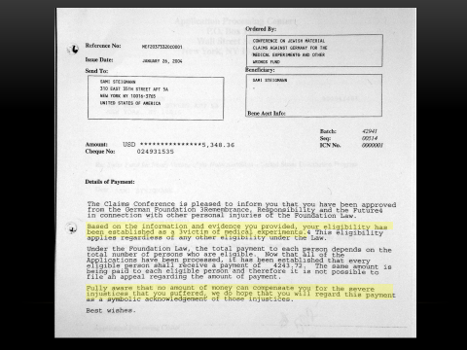

Slide 24
Holocaust survivor who underwent Nazi medical experiments shares his story with Bayonne 7th graders
By Jonathan Lin | The Jersey Journal on May 06, 2015
By Jonathan Lin | The Journal on May 06, 2015By Jonathan Lin | The Journal on May 06, 2015
BAYONNE May 6, 2015
Sami Steigmann doesn't remember
what medical experiments the Nazis did to him as a child
but after more than 70 years, they still cause him pain every day.
Despite that suffering, the 75-year-old Holocaust survivor says
he has stopped thinking of himself as one of the “victims" who were imprisoned and abused at a Nazi labor camp in
Mogilev Podolski, Ukraine…
…In a presentation today to hundreds of 7th graders visiting
Bayonne High School, Steigmann shared his life story,
citing other difficult experiences such as
being homeless at one point in New York
and being unable to see his grandchildren.

Slide 25
By Jonathan Lin | The Jersey Journal on May 06, 2015
By Jonathan Lin | The Jersey Journal on May 06,015
Jew Holohoaxer Claims Nazi Medical Experiment He Can’t Remember Still Cause Him Pain
Daily Slave, May 8, 2015
riment
Unlike the millions of other Jew Holohoaxers he somehow was not experimented on by Josef Mengele.
…Surprisingly he did not invoke Josef Mengele’s name in reference to these alleged experiments.
This Jew is nothing but a lying rat. These Jews need to be banned from speaking to students. Instead they need to be locked up in FEMA camps.
→ Based on the exact copy of The Jersey Journal article

Slide 26
Q & A

Slide 27
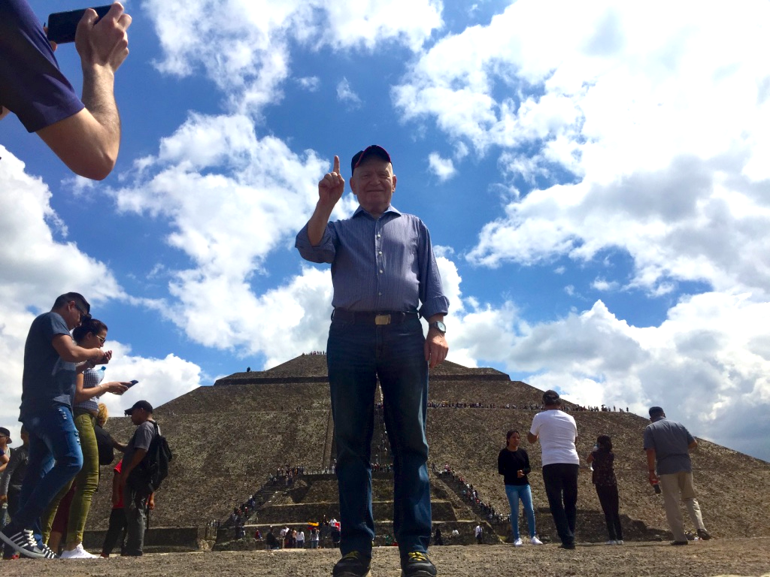
Sami Steigmann

Slide 28
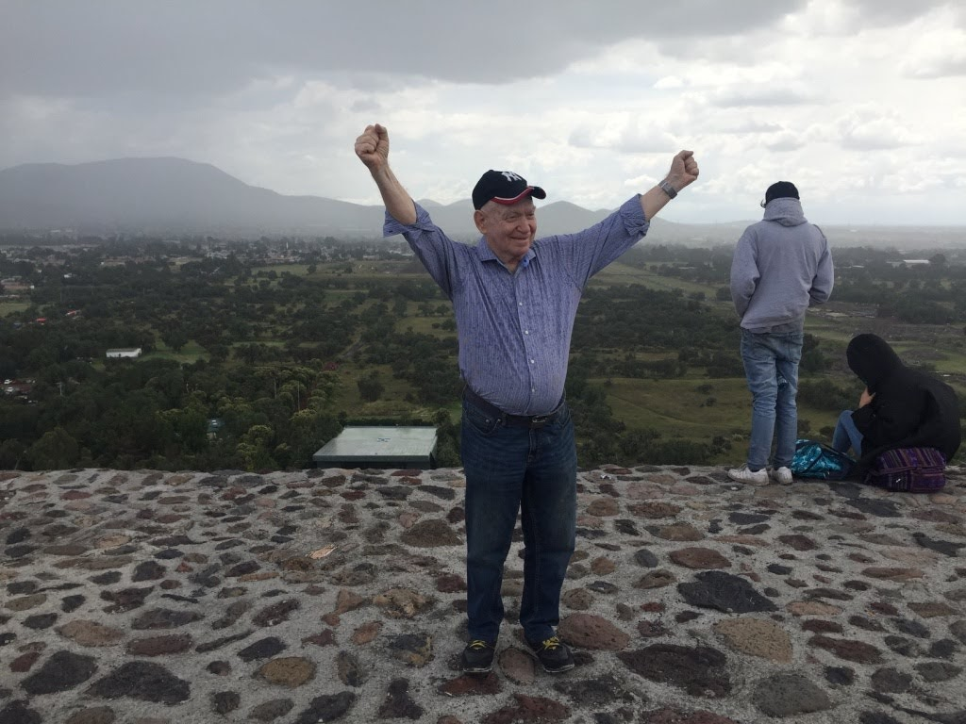

Slide 29
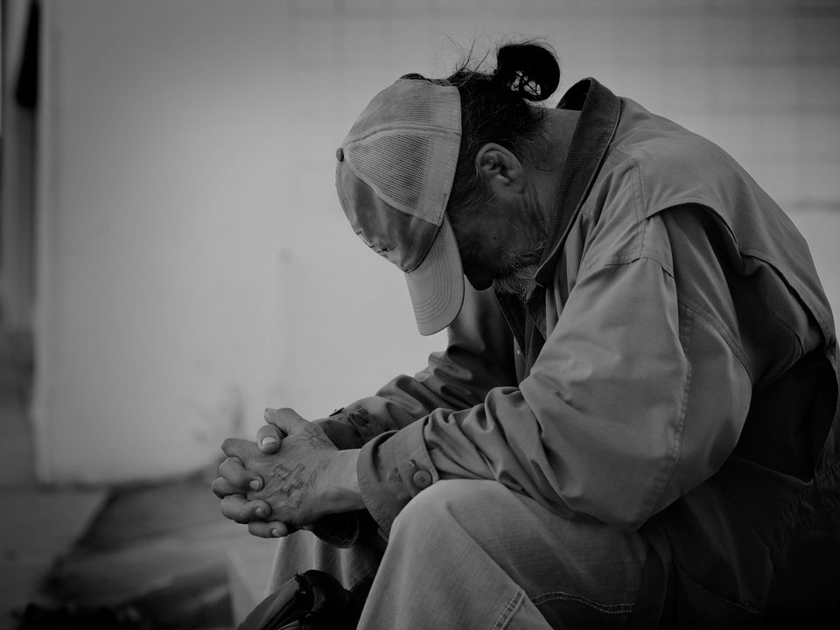
56

Slide 30
ROAD to RECOVERY
1.) Big Apple Greeter (taking visitors, from other states and other countries, around the city).
2.) H.A.I. (distributing tickets to underprivileged people)

Slide 31
NOT ALLOWED
to be in touch with my grandchildren

Slide 32
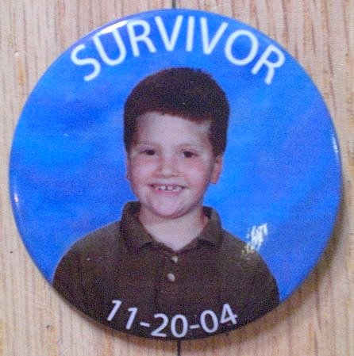
OPTIMISM versus PESSIMISM
SURVIVOR versus VICTIM
An OPTIMIST sees in every problem an OPPORTUNITY
A PESSIMIST sees in every opportunity a PROBLEM

Slide 33
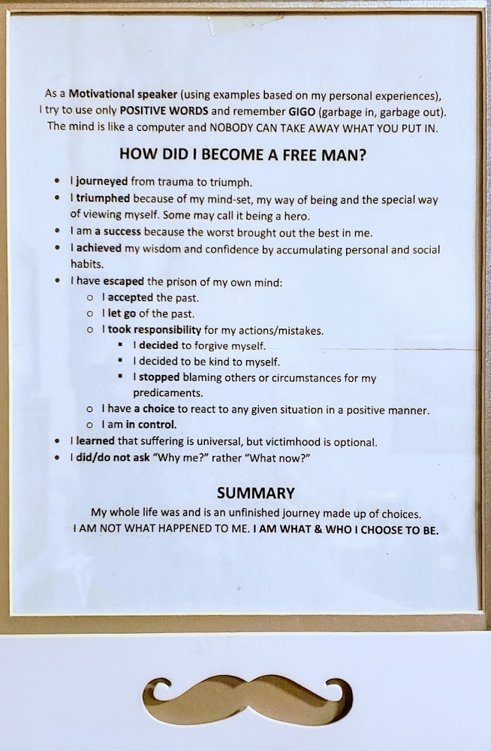

Slide 34
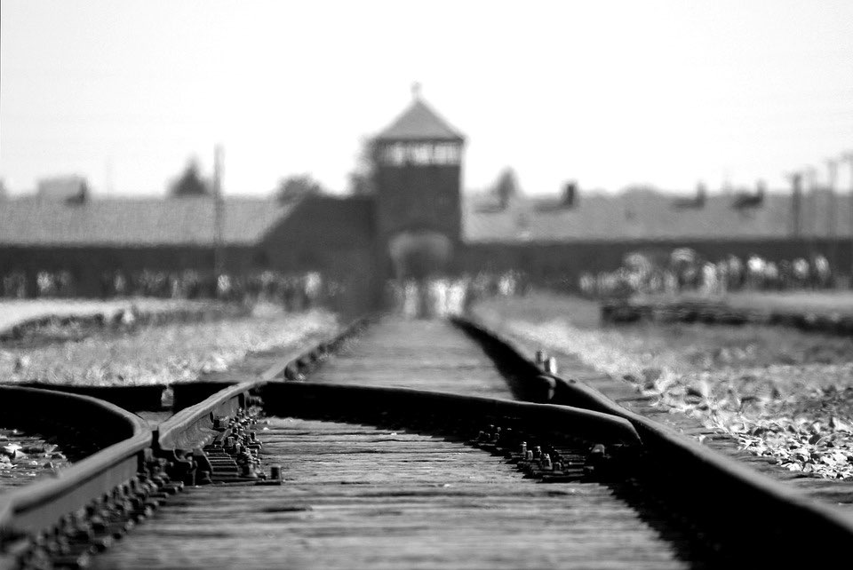
A SURVIVOR’s REQUEST
I am a survivor of a concentration camp.
My eyes saw what no man should witness.
Gas chambers built by learned engineers.
Children poisoned by educated physicians.
Infants killed by trained nurses.
Women and babies shot and burned by high school and college gradua
TEACHERS
TEACH not only the MIND but also the HEART
STUDENTS
Do the RESEARCH. Not everything that you read, hear or see
is the Gospel truth

Slide 35
TO SUMARIZE
NEVER BE A PERPETRATOR hurting somebody intentionally and repeatedly.
NEVER BE A VICTIM by keeping it to yourself. SPEAK UP.
NEVER, NEVER BE A BY-STANDER and be part of the problem.
BE AN UP-STANDER and part of the solution!!!
IT’S YOUR FUTURE.
MAKE IT A BETTER WORLD FOR YOURSELF, YOU CHILDREN AND GRANDCHILDREN

Slide 36
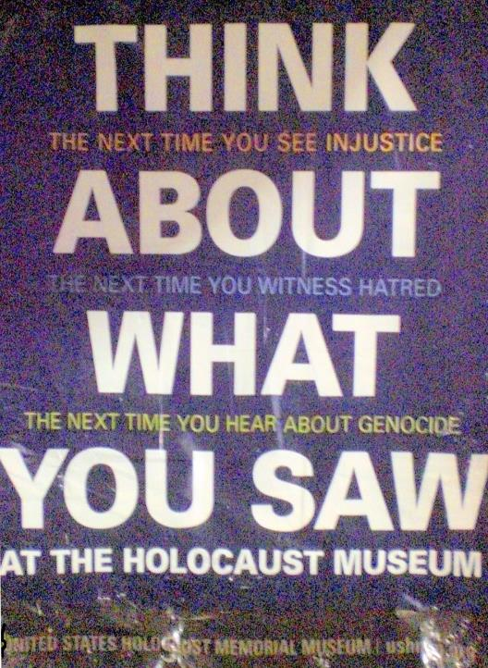

Slide 37
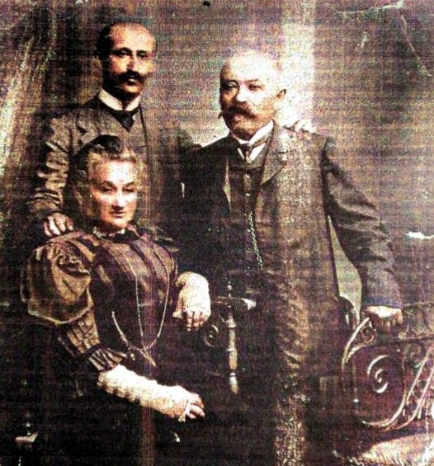
Family history
GREAT-GRANDPARENTS

Slide 38
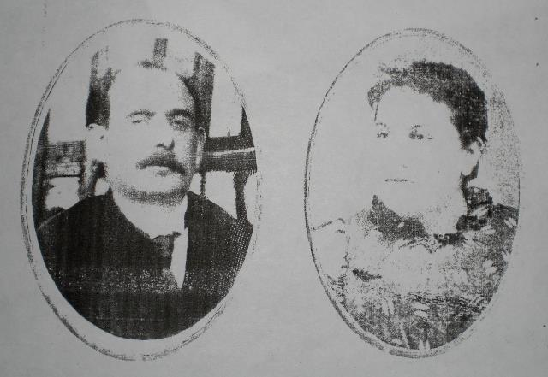
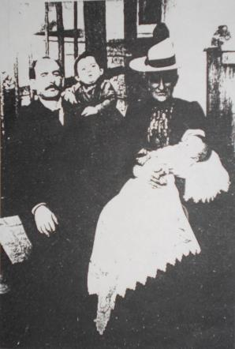

Slide 39
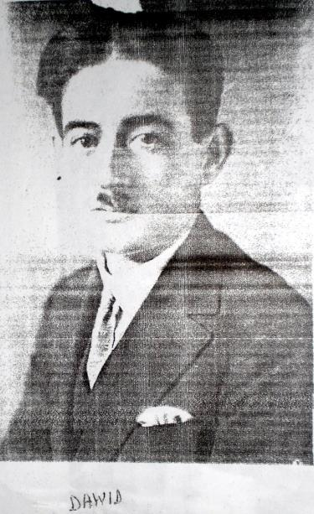
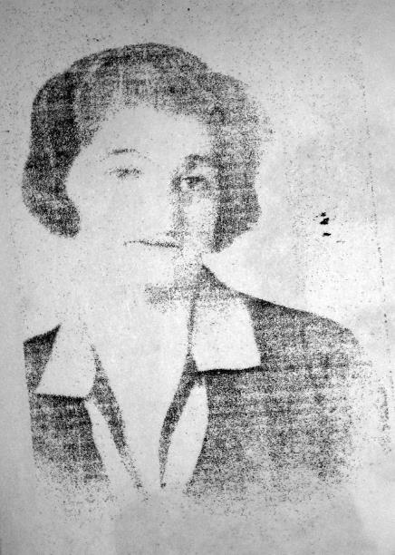
Uncle DAVID and Aunt (Tante) FANNY
MURDERED in AUSCHWITZ

Slide 40
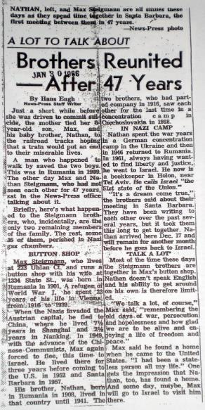
“Nathan and Max Steigmann
are all smiles these days as they spend time together the first meeting between them in 47 years.”

Slide 41
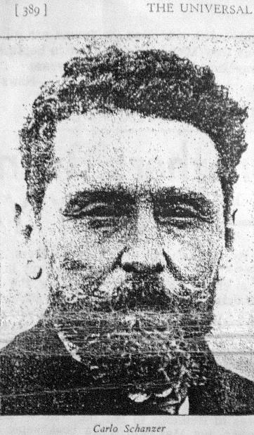
I am his 1st cousin twice removed

Slide 42
CARLO SCHANZER
Born in Vienna, Austria on December 18, 1865
Died in Rome, Italy on October 23, 1953
Italian Minister of Foreign Affairs
1922
Succeeded by Benito Mussolini

Slide 43
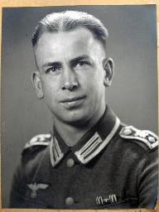
WALKING the TALK
Since I believe in HARMONY and RECONCILIATION, I attended the MARCH of LIFE conference
in Tuebingen, Germany
Klaus’ Grandpa
“NO WORDS CAN MAKE THE CRUELTIES UNDONE, BUT I WANT TO SPEAK THE WORDS,
MY GRANDFATHER SHOULD HAVE DONE: I WAS TOTALLY WRONG.
I MURDERED. COULD YOU PLEASE FORGIVE?”
(passed away 2009)

Slide 44
I AM NOT WHAT HAPPENED TO ME
I AM WHAT I CHOOSE TO BE
If you are not indifferent, things can be different.

Slide 45
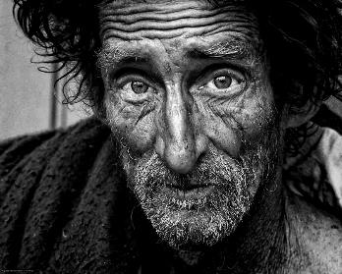
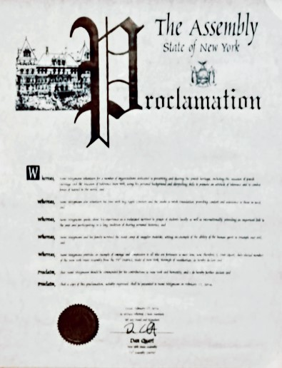
From the ASHES to SUCCESS (as a HUMAN BEING)

Slide 46
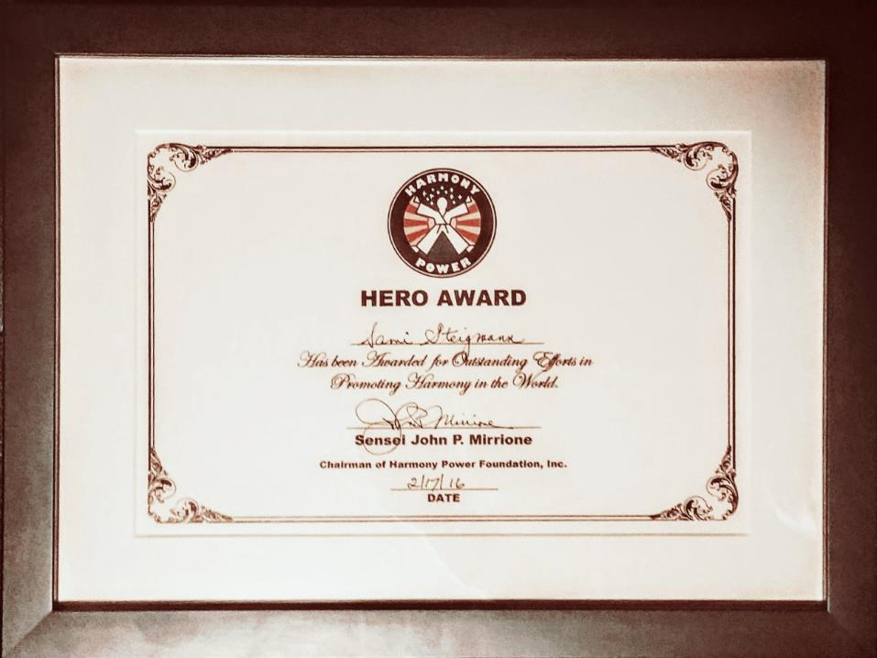
Promoting HARMONY around the world

Slide 47
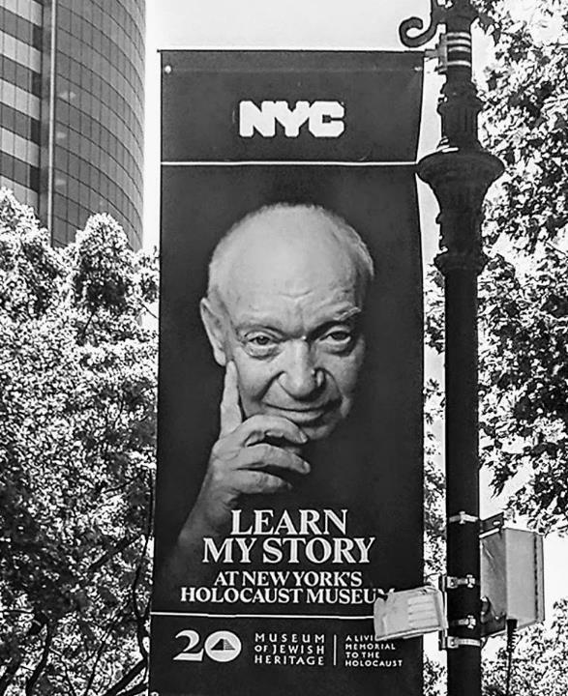

Slide 49
Proudest moments in my life

Slide 50
The birth of my son
1
Joy of
parenting

Slide 51
OVERCOMING
HATE
2

Slide 52
BEING HOMELESS
Discovering hidden talents and life’s mission
3

Slide 53
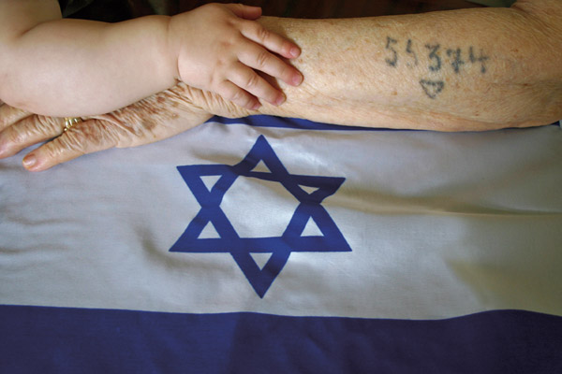
Power of suggestion

Slide 54
The feeling of BELONGING through a personal contact

Slide 56
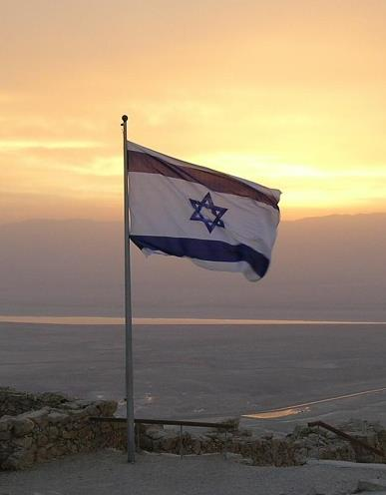
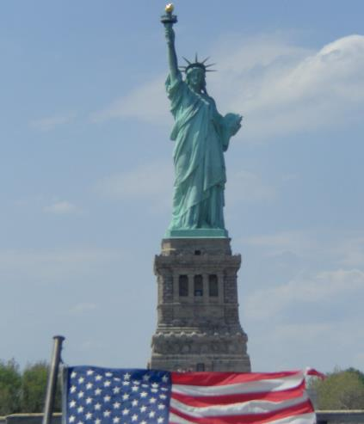
FREEDOM

Slide 57
Zionism
Right of the Jewish people to feel safe and secure in their homeland.
No other state would accept Jews before Israel was created-during the time of the Holocaust and beyond.
Founded originally at the first Zionist Congress by Herzl but brought to reality by David Ben Gurion.
Fought for in the War of Independence when Israel was attacked by 6 Arab Nations.
A social justice movement for the Jewish people.

Slide 58
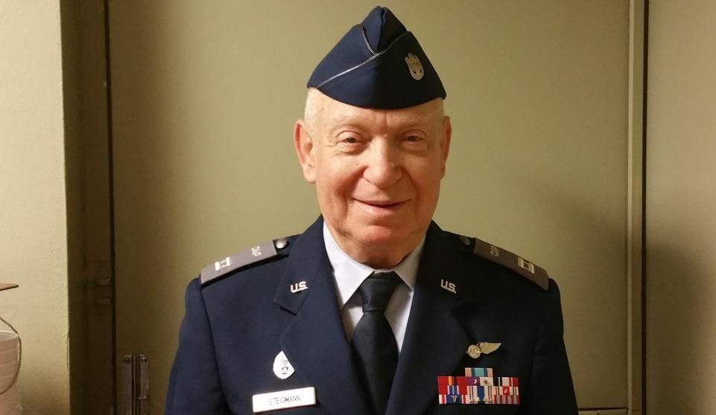
Civil Air Patrol (Served in the IDF)

Slide 60
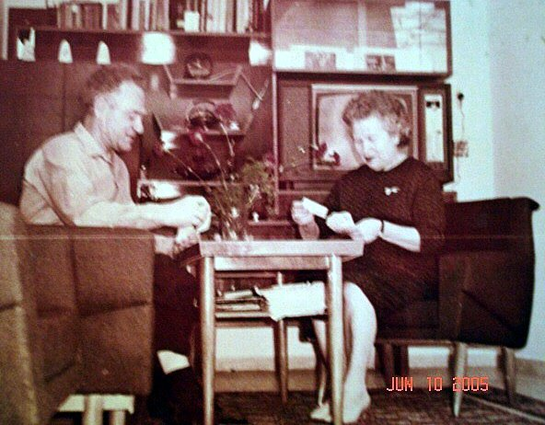

Slide 61
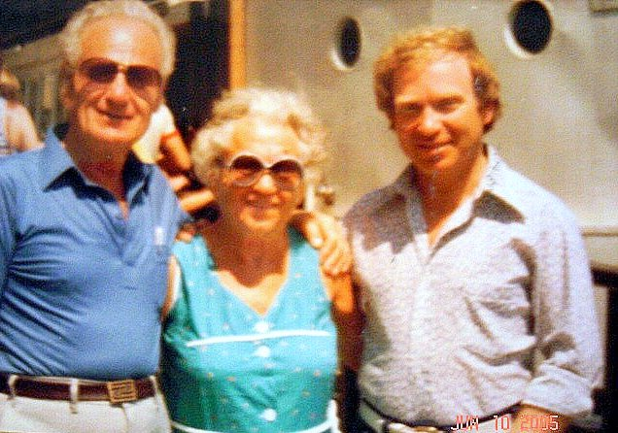

Slide 62
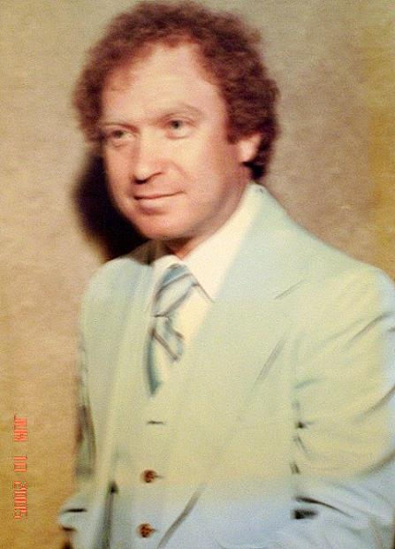
Curly hair for a month

Slide 63
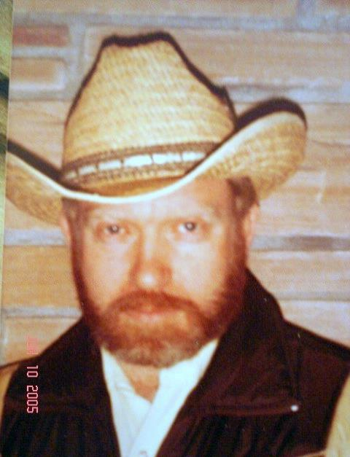
Cowboy for a day

Slide 64
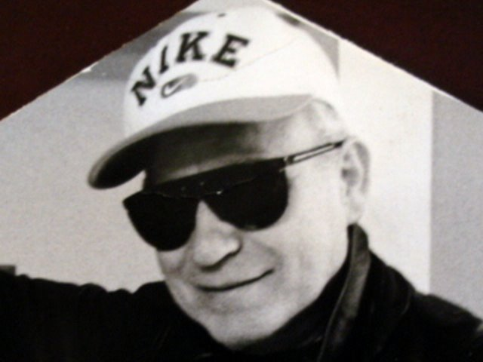
In the shelter
Still dignified

Slide 65
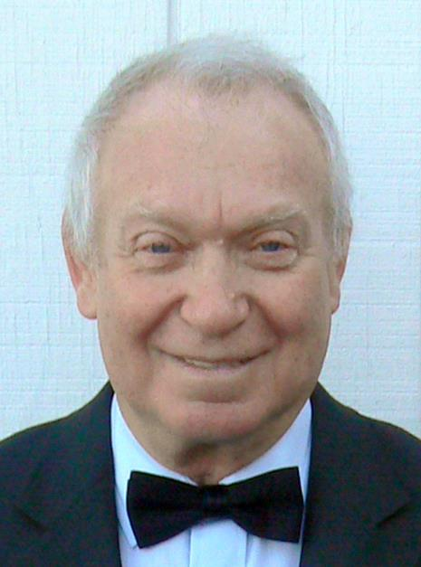
Tuxedo on a cruise

Slide 66
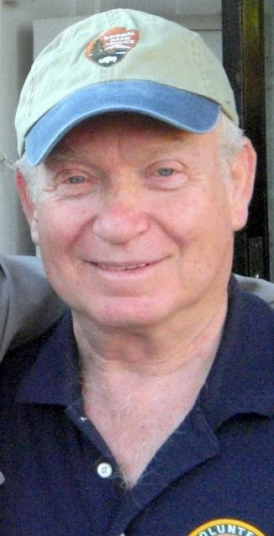
Volunteering

Slide 67
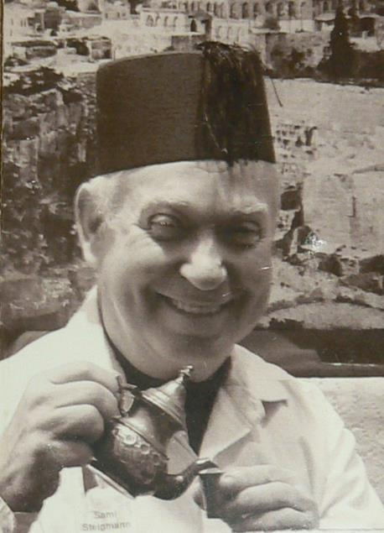
Turk for a day

Slide 68
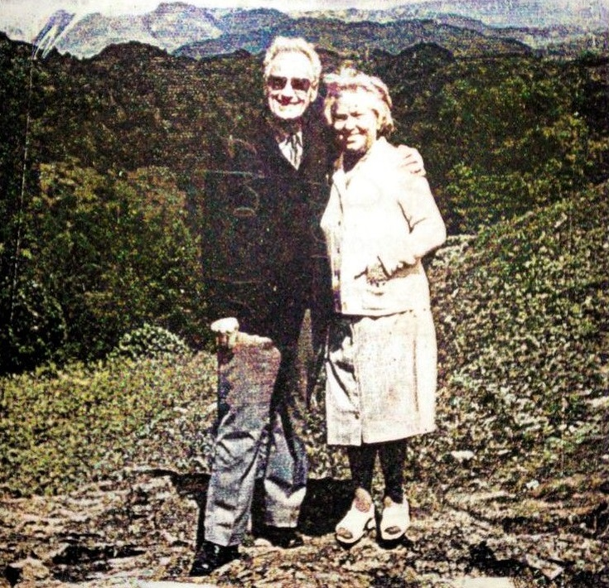

Slide 69
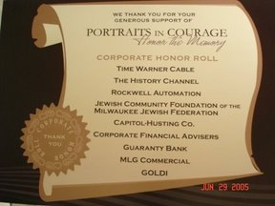

Slide 70
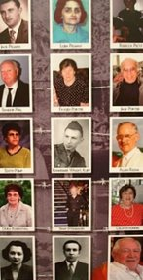
Reunion of Milwaukee survivors

Slide 71
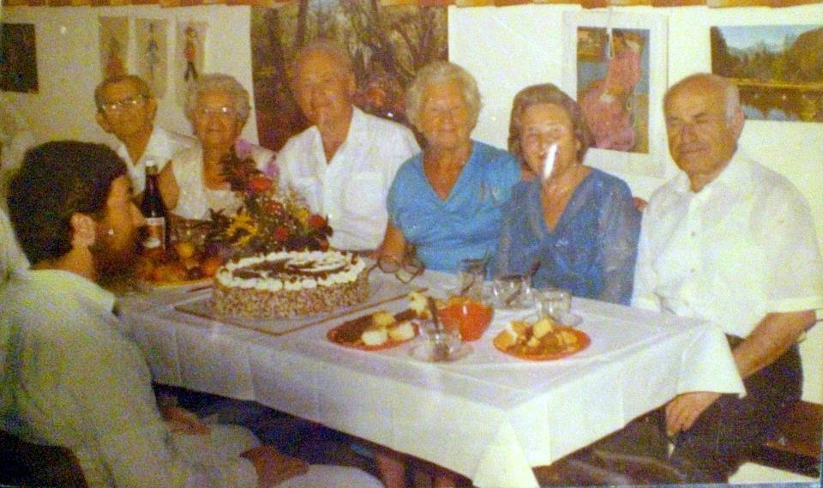
Celebrating 50th wedding anniversary

Slide 72
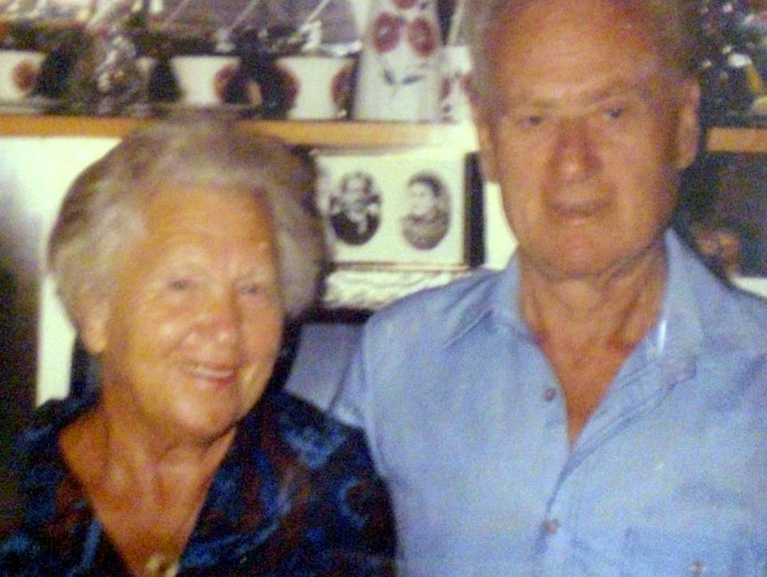

Slide 74
Miss New York

Slide 75
Let’s keep in touch!
Samispeaks.com
sami1939@gmail.com

Slide 76
¡GRACIAS! Deseo volver con ustedes cada año…
VIVA

Slide 77
SAMISPEAKS.COM

